Slide 1
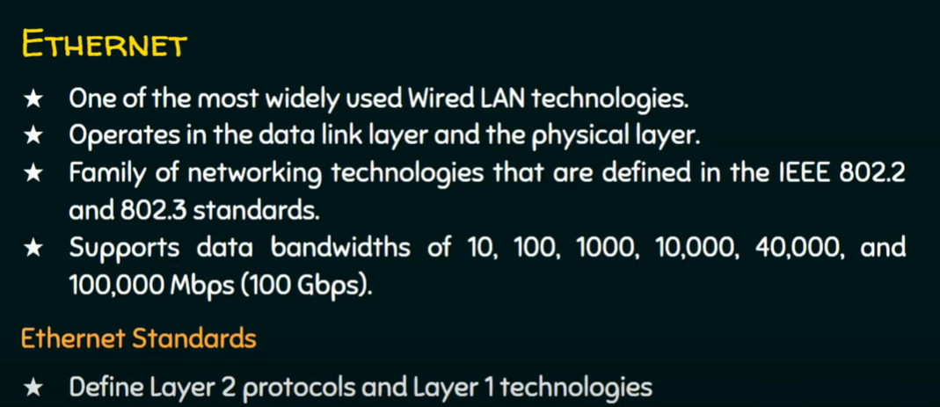

Slide 2
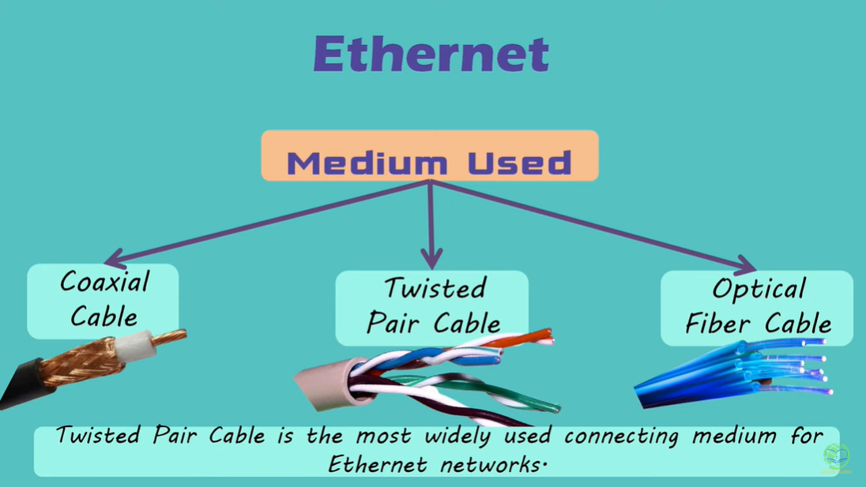

Slide 3
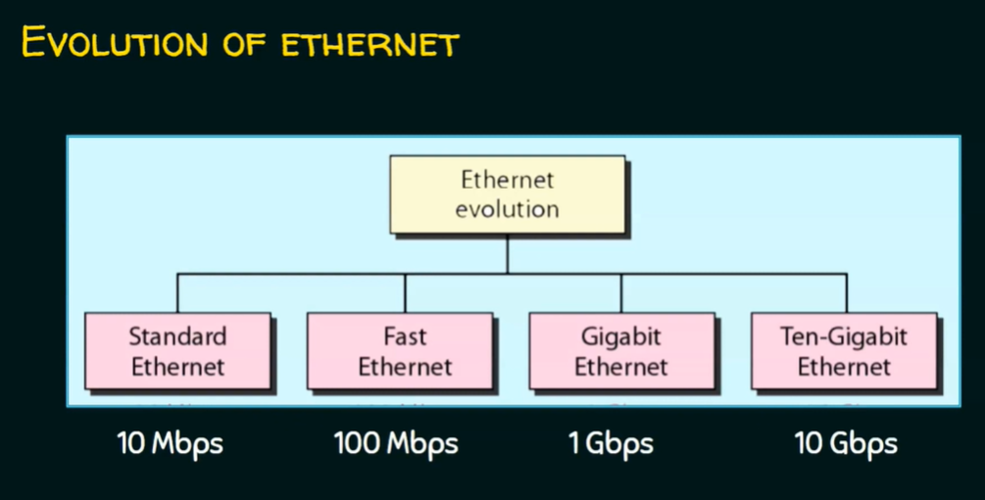

Slide 4
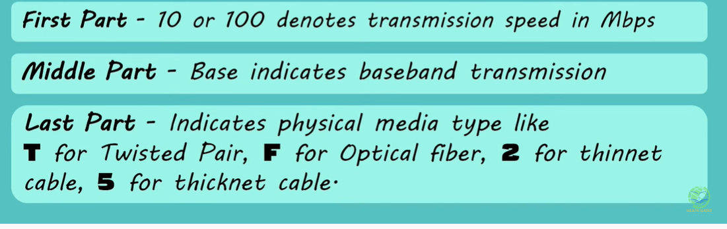
Standard Ethernet Types
10 Base2
10 Base 5
10 Base T
10 Base F

Slide 5
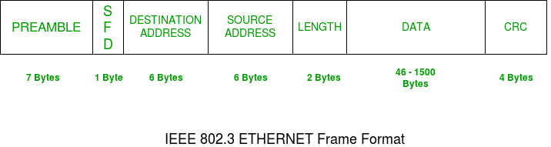

Slide 6
PREAMBLE – Ethernet frame starts with 7-Bytes Preamble. This is a pattern of alternative 0’s and 1’s which indicates starting of the frame and allow sender and receiver to establish bit synchronization.
Start of frame delimiter (SFD) – This is a 1-Byte field which is always set to 10101011. SFD indicates that upcoming bits are starting of the frame, which is the destination address.
Destination Address – This is 6-Byte field which contains the MAC address of machine for which data is destined.
Source Address – This is a 6-Byte field which contains the MAC address of source machine. As Source Address is always an individual address (Unicast), the least significant bit of first byte is always 0.
Length – Length is a 2-Byte field, which indicates the length of entire Ethernet frame. This 16-bit field can hold the length value between 0 to 65534, but length cannot be larger than 1500 because of some own limitations of Ethernet.
Data – This is the place where actual data is inserted, also known as Payload.
CRC is 4 Byte field.

Slide 7
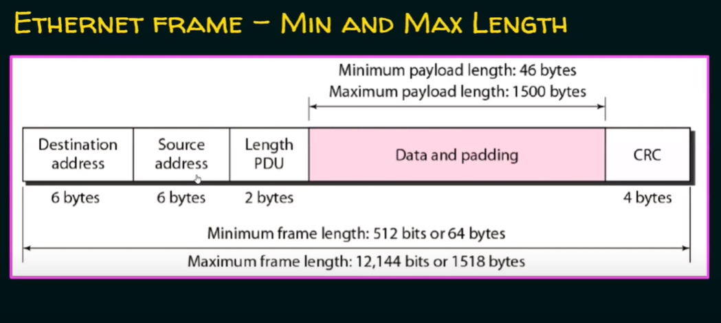

Slide 8
